Slide 1

Alzheimer Disease Detection and Mental Stress Analysis using EEG Signals
SRM INSTITUTE OF SCIENCE AND TECHNOLOGY
FACULTY OF ENGINEERING AND TECHNOLOGY
DEPARTMENT OF NETWORKING AND COMMUNICATIONS
18CSP109L MAJOR PROJECT
Student : Kaushik Tayi Reg No: RA2011030010048
Guide name and Designation:
Dr. Prabakeran S (Assistant Professor)
Department of Networking And Communications

Slide 2
TABLE OF CONTENTS
Abstract
Introduction
Motivation
Literature Review
Challenges and limitations in existing system
Objectives of the project
Innovation idea of the project
Scope and application of the project
Architecture
Proposed Modules and their algorithm description

Slide 3
ABSTRACT
Alzheimer disease poses a significant challenge to global healthcare systems, necessitating early and accurate detection methods for effective intervention and management. In this study, we present a novel approach to Alzheimer detection leveraging EEG markers and mental stress analysis within a streamlined application framework. Our system incorporates EEG electrode data, allowing for comprehensive analysis of cognitive decline in conjunction with mental stress assessment. By integrating EEG data with Advanced machine learning techniques, specifically Random Forest Classifier, our application offers robust and precise predictions of Ad disease presence and progression. The innovative aspect of our approach lies in the integration of mental stress analysis, providing a holistic understanding of cognitive health. Through our Streamlit application, users can access a user-friendly interface for seamless interaction and interpretation of results. Our findings demonstrate promising potential for enhancing Alzheimer detection methodologies by integrating EEG markers and mental stress analysis, paving the way for more effective clinical interventions and personalized care strategies.

Slide 4
INTRODUCTION
This innovative system is underpinned by a sophisticated Streamlit application, designed to provide comprehensive analysis of Alzheimer pathology intertwined with mental stress dynamics, utilizing EEG electrode data. Central to its efficacy is the utilization of Random Forest Classifier, a robust machine learning algorithm, which empowers the system to discern intricate patterns and signatures indicative of Alzheimer progression amidst varying stress levels.
In the pursuit of accuracy and reliability, the dataset is meticulously partitioned with a strategically devised split ratio, ensuring optimal model training while guarding against overfitting. Moreover, the model training process is fine tuned with carefully calibrated parameters, meticulously tailored to extract maximal predictive power from the EEG data.
Through this amalgamation of cutting-edge technologies and meticulous methodology, our Alzheimer Detection system emerges as a beacon of hope, offering early intervention and personalized insights to combat the ravages of neurodegenerative diseases.

Slide 5
MOTIVATION
Early Intervention and Treatment: Timely interventions and individualized treatment strategies must be implemented as soon as AD is diagnosed.
Addressing Diagnostic Challenges: Conventional diagnostic methods for AD, such as clinical assessment and neuroimaging techniques, often encounter limitations related to accuracy, accessibility, and cost-effectiveness.
Advancements in Machine Learning: Recent advancements in machine learning and computational neuroscience have opened up new avenues for analyzing complex biomedical data, including EEG signals.
Clinical Translation and Impact: Ultimately, our research aspires to translate scientific findings into tangible clinical solutions with significant societal impact.

Slide 6
LITERATURE REVIEW
Convolutional Neural Networks (CNNs) and Recurrent Neural Networks (RNNs), tailored for analyzing Electroencephalography (EEG) signals. This approach aims to harness the temporal and spatial information present in EEG data for accurate detection of Alzheimer's disease and assessment of mental stress levels.
The review systematically examines the performance of the proposed deep learning model across multiple publicly available EEG datasets, including ADNI (Alzheimer's Disease Neuroimaging Initiative) and DEAP (Database for Emotion Analysis using Physiological Signals).
By acknowledging the inherent challenges in EEG-based diagnosis, such as variability in signal quality and interpretability, the review underscores the need for innovative strategies to enhance model robustness and generalization.
The significance of collaborative efforts among researchers and clinicians to establish standardized protocols and benchmarks for benchmarking and validating EEG-based diagnostic models in real-world clinical settings.

Slide 7
CHALLENGES AND LIMITATIONS IN EXISTING SYSTEM
Signal Noise and Artifact Interference: Existing EEG-based systems encounter challenges related to signal noise and artifacts, stemming from various sources such as muscle movements, eye blinks, and environmental electromagnetic interference.
Limited Inter-subject Variability: Many existing systems exhibit limitations in capturing the inherent inter-subject variability present in EEG signals, particularly concerning demographic factors, cognitive abilities, and emotional states.
Clinical Interpretability and Validation: Interpretability and validation of EEG-based diagnostic findings pose significant challenges in existing systems, as the complex nature of neural activity patterns requires comprehensive understanding and clinical validation
Ensuring the reliability and interpretability of diagnostic outcomes is crucial for facilitating the integration of EEG-based analyses into clinical decision-making processes for Alzheimer's disease diagnosis and mental stress assessment.

Slide 8
OBJECTIVES OF THE PROJECT
Development of a Deep Learning Framework: The primary objective of the project is to design and implement a robust deep learning framework tailored for Alzheimer's disease detection and mental stress analysis using EEG signals.
This framework will integrate state-of-the-art neural network architectures and signal processing techniques to extract meaningful features from EEG data, enabling accurate classification of cognitive impairment and stress levels.
Exploration of Biomarkers and Diagnostic Markers: The project aims to identify and characterize EEG-based biomarkers associated with Alzheimer's disease progression and mental stress, facilitating early detection and intervention strategies.
Evaluation and Validation in Clinical Settings: An essential objective is to evaluate the efficacy and reliability of the developed framework in real-world clinical settings. Collaborating with healthcare professionals and research institutions, the project will conduct comprehensive validation studies using diverse patient cohorts and longitudinal EEG datasets.

Slide 9
INNOVATION IDEA OF THE PROJECT
This multi-modal data fusion technique aims to leverage the unique strengths of each modality, combining the temporal resolution of EEG with the spatial specificity of fMRI and the physiological markers of stress, to provide a comprehensive and holistic view of brain function and cognitive health.
By fusing multi-modal data streams using advanced machine learning algorithms, such as deep neural networks and graph-based models, the project seeks to uncover synergistic relationships and hidden patterns that may not be discernible from individual modalities alone.
The integration of multi-modal data fusion represents a paradigm shift in neuroimaging-based diagnostics, offering a more comprehensive understanding of brain health and cognitive function.
This innovation has the potential to significantly advance the field of Alzheimer's disease detection and mental stress analysis, paving the way for personalized and precision medicine approaches tailored to individual patient profiles.

Slide 10
SCOPE AND APPLICATION
Scope:
The project aims to develop an accurate and sensitive diagnostic tool for early detection of Alzheimer's disease and cognitive impairment. By leveraging EEG signals and advanced machine learning techniques, the framework can identify subtle changes in brain activity patterns associated with neurodegenerative processes, enabling timely intervention and treatment strategies to mitigate disease progression.
Application:
Monitoring Disease Progression: The developed framework can be utilized for longitudinal monitoring of Alzheimer's disease progression and cognitive decline. By analyzing EEG data over time, clinicians can track changes in neural activity patterns and assess the efficacy of therapeutic interventions, facilitating personalized treatment plans and adjustments based on individual patient responses.
Stress Assessment and Management: In addition to Alzheimer's disease detection, the project addresses the assessment of mental stress levels using EEG signals. The framework can provide objective measures of stress-related brain activity patterns, facilitating early identification of stress-related disorders and informing personalized stress management interventions, such as cognitive-behavioral therapy and mindfulness-based techniques.
Research and Scientific Discovery: The project contributes to advancing scientific knowledge in the fields of neuroscience and neuroimaging by uncovering novel biomarkers and neural correlates associated with Alzheimer's disease and mental stress. The insights gained from analyzing EEG data using state-of-the-art machine learning algorithms can inform future research directions and therapeutic targets, driving innovation in neurodegenerative disease research and stress-related disorders.

Slide 11
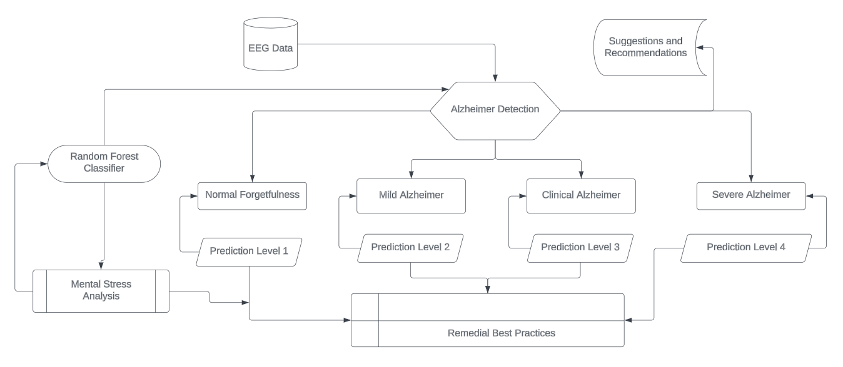
ARCHITECTURE

Slide 12
PROPOSED MODULES
Deep Learning-Based EEG Classification Model:
The project proposes the development of several models tailored for Alzheimer's disease detection and mental stress analysis using EEG signals. The first model involves a deep learning-based approach, employing Convolutional Neural Network (CNN) or Recurrent Neural Network (RNN) architectures optimized for sequential EEG data processing.
Input data would consist of preprocessed EEG signals segmented into time windows, potentially augmented with spectral features or wavelet transforms to capture relevant temporal and frequency-domain information. Input data would consist of preprocessed EEG signals segmented into time windows, potentially augmented with spectral features or wavelet transforms to capture relevant temporal and frequency-domain information.
Another proposed model involves the utilization of Graph Neural Networks (GNNs) for brain network analysis derived from EEG data. Here, functional connectivity matrices computed from EEG signals using methods like coherence or correlation analysis serve as input, capturing the complex interactions within brain networks.
A third proposed model explores a hybrid approach integrating EEG data with physiological signals, such as heart rate variability and skin conductance, using multi-modal fusion techniques. This model would fuse features extracted from EEG and physiological signal modalities, potentially incorporating attention mechanisms to prioritize relevant information from each modality.

Slide 13
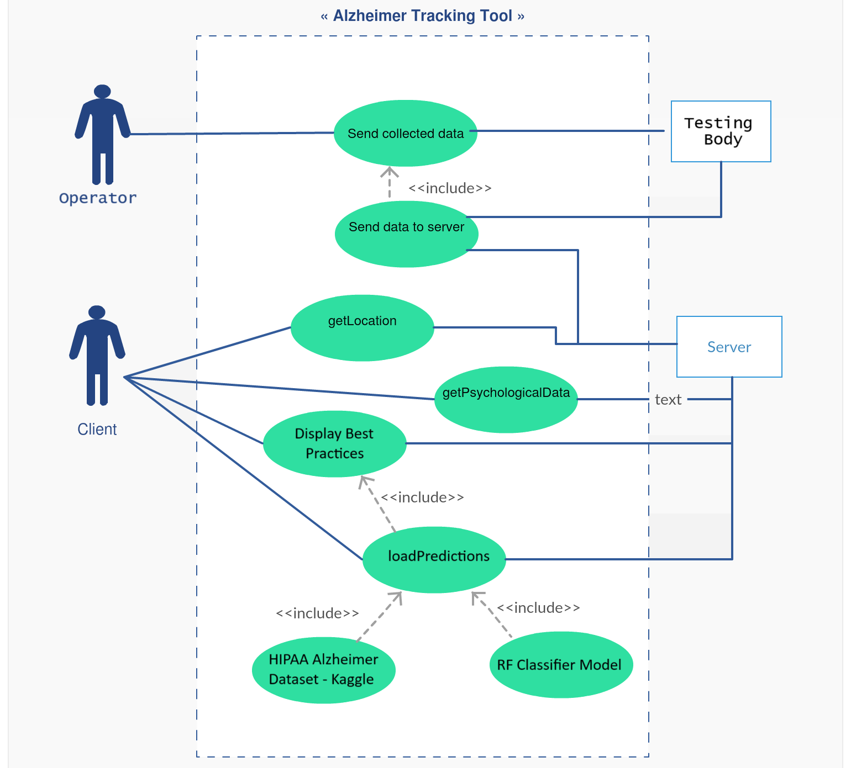
UML DIAGRAMS FOR THE PROPOSED MODULES

Slide 14
Thank You

